Slide 1
E-MAIL (SMTP, POP3, IMAP4); FTP

Slide 2
Electronic mail (E-mail)
Allows users to exchange messages.
It is an asynchronous communication medium.
In HTTP,
the server program is running all the time, waiting for a request from a client.
when the request arrives, the server provides the service.
In E-mail:
It is considered as one-way transaction.
Sender may expect a response, but this is not a mandate.
it is neither feasible nor logical for the receiver to run a server program and wait until someone sends an e-mail to him.
the idea of client/server programming should be implemented in another way: using intermediate servers.
both the end users run only client programs when they want, and the intermediate servers apply the client/server paradigm

Slide 3
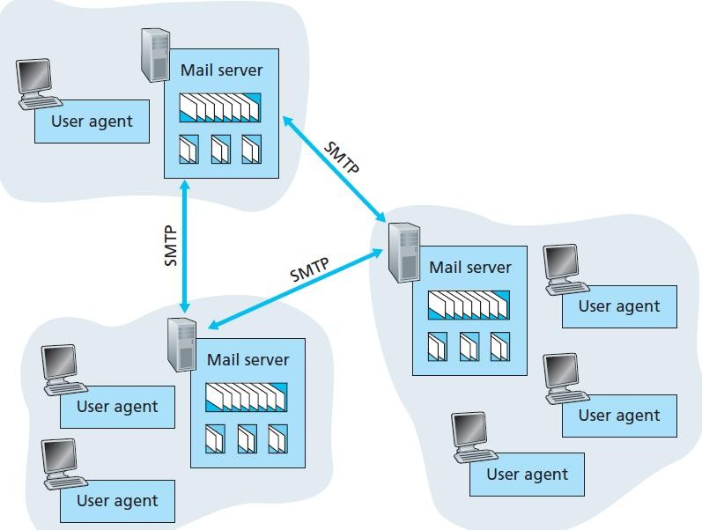


High-level view of Internet e-mail system

Slide 4
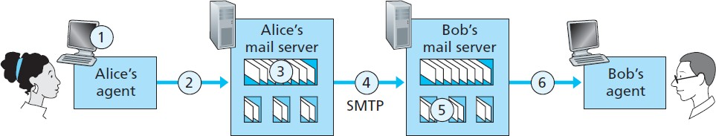
Architecture
User agent
allows user to read, reply to, forward, save, and compose messages.
e.g., Microsoft Outlook, Google Gmail
Mail server
form the core of the e-mail infrastructure
Mailbox
Each user has a mailbox located in one of the mail servers.
Application-layer protocol
transfer mail from the sender’s mail server to the recipient’s mail server
e.g., Simple Mail Transfer Protocol (SMTP)
SMTP has two sides: a client side, and a server side
Journey of a message
sender’s user agent --> sender’s mail server --> recipient’s mail server --> recipient’s user agent

Slide 5
SMTP v/s HTTP
HTTP transfers files (also called objects) from a Web server to a Web client (typically a browser)
SMTP transfers files (that is, e-mail messages) from one mail server to another mail server.
Both persistent HTTP and SMTP use persistent connections
HTTP is mainly a pull protocol - someone loads information on a Web server and users use HTTP to pull the information from the server at their convenience
SMTP is primarily a push protocol - the sending mail server pushes the file to the receiving mail server.
In HTTP, TCP connection is initiated by the machine that wants to receive the file
In SMTP, the TCP connection is initiated by the machine that wants to send the file
SMTP requires each message, including the body of each message, to be in 7-bit ASCII format. This restriction made sense in the early 1980s when transmission capacity was scarce.
HTTP data does not impose this restriction.

Slide 6
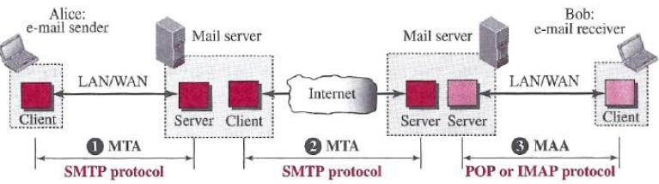
Message Access Protocol: POP,IMAP
Once SMTP delivers the message from Alice’s mail server to Bob’s mail server, the message is placed in Bob’s mailbox.
Until the early 1990s, Bob used to read his mail by logging onto the server.
But today, mail access uses a client-server architecture - typical user reads e-mail with a client that executes on the user’s end system
Bob’s user agent can’t use SMTP to obtain the messages because SMTP is a push protocol
Mail access protocols use by Bob’s user agent
Post Office Protocol—Version 3 (POP3),
Internet Mail Access Protocol – version 4 (IMAP4)

Slide 7
Mail Transfer Phases
The following three mail transfer phases begins as soon as
the TCP connection is established to the well-known port 25 (for non-encrypted version)
Note: After a client has made a TCP connection the SMTP protocol starts its connection phase.
The process of transferring a mail message occurs in three phases:
Mail transfer connection establishment by SMTP,
Perform mail transfer,
Mail transfer connection termination by SMTP.

Slide 8
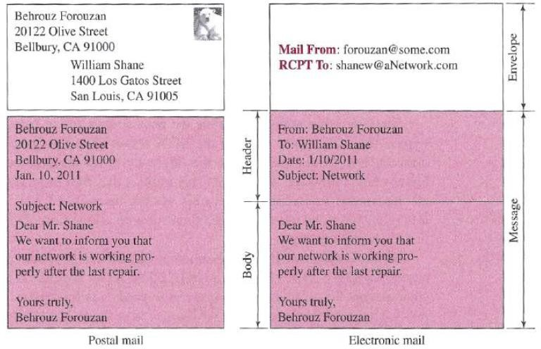
Cont…
To send mail, the user, through the user agent (UA), creates mail that looks very similar to postal mail.
Postal Mail
Electronic Mail

Slide 9
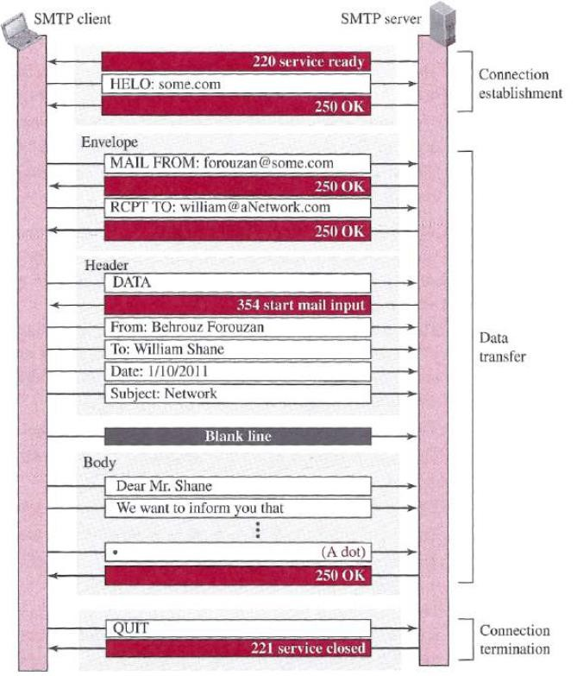
Cont…
SMTP
Message exchange between SMTP client and server:
SMTP server sends code 220 (service ready) to tell the client that it is ready to receive mail.
The client sends the HELO message to identify itself, using its domain name.
The server responds with code 250 (request command completed)
Content of the mail Terminated by just a dot
Other commands: MAIL FROM; RCPT TO; DATA; QUIT
SMTP
Dr. Manas Khatua 9

Slide 10
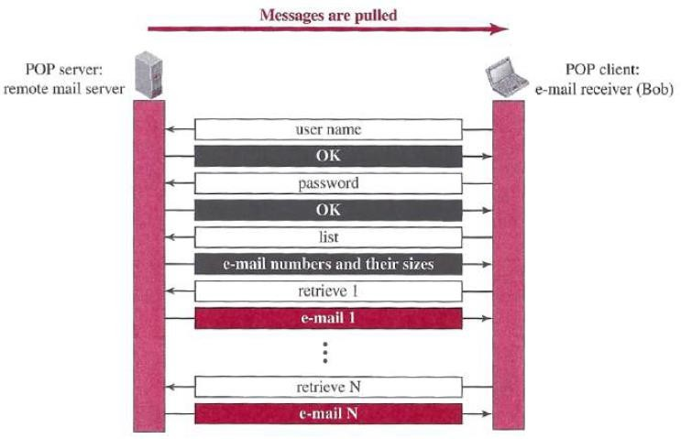
POP3
In POP3, user agent (UA) opens a TCP
connection to the mail server on port 110.
POP3 progresses through three phases:
authorization,
transaction, and
update
In POP3 transaction, the user agent (UA) issues commands, and the server replies to each command with a response. Two possible responses: +OK; and –ERR
User agent can be configured to two modes:
“download and delete”
“download and keep.”
The download-and-delete mode partitions Bob’s mail messages over the machines – downloaded to the accessing PC, and removed from the mail server

Slide 11
IMAP4
IMAP4 is similar to POP3, but it has more features; IMAP4 is more powerful and more complex.
IMAP4 provides the following extra functions:
A user can check the e-mail header prior to downloading.
A user can search the contents of the e-mail for a specific string of characters prior to downloading.
A user can partially download e-mail.
This is especially useful if bandwidth is limited and the e-mail contains multimedia with high bandwidth requirements.
An IMAP server will associate each message with a folder.
A user can create, delete, or rename mailboxes (i.e. folders) on the mail server.
A user can create a hierarchy of mailboxes in a folder for e-mail storage.

Slide 12
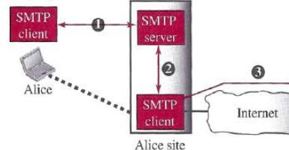
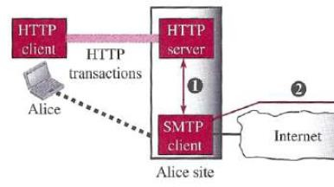
Web-Based Mail
An email client, email reader or more formally mail user agent (UA) is a computer program used to access and manage a user's email.
E.g. Mozilla Thunderbird, IMAP clients, Lotus Notes clients – Use SMTP to send, IMAP/POP to receive
Webmail (or web-based email) is any email client implemented as a web application running on a web server. – Use HTTP to send and receive
Webmail's main advantage over the use of a desktop email client is the ability to send and receive email anywhere from a web browser.
Webmail’s main disadvantage is the need to be connected to the Internet while using it.
E.g., Outlook/Hotmail, Yahoo, and Google.
Desktop Mail user agent uses SMTP
Webmail uses HTTP

Slide 13
E-Mail Security
The protocol discussed so far does not provide any security provisions per se.
e-mail exchanges can be secured using two application-layer securities
designed in particular for e-mail systems
Pretty Good Privacy (PGP)
Secure/Multipurpose Internet Mail Extensions (S/MIME)

Slide 14
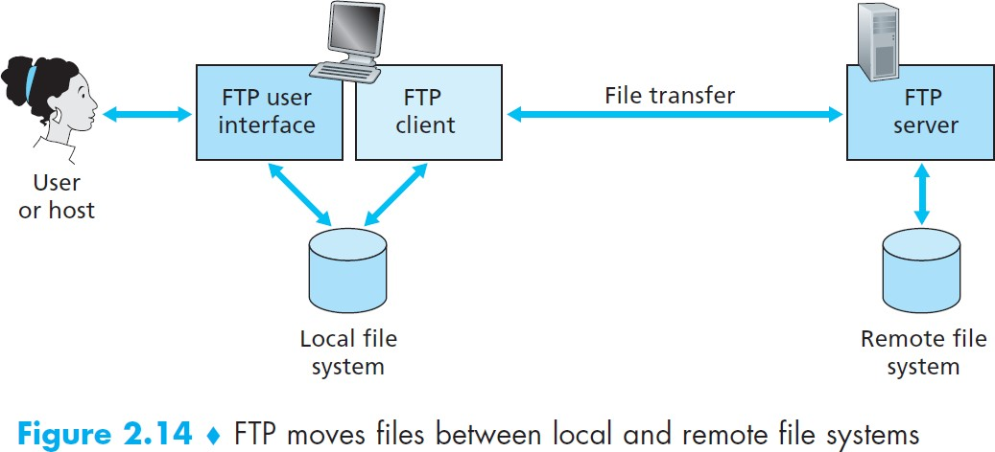
FTP (File Transfer Protocol)
In a typical FTP session, the user is sitting in front of one host (the local host) and wants to transfer files to or from a remote host
user accessing the remote account
– user must provide a user identification and a password.
FTP must address the following:
two systems may use different file name conventions
two systems may have different ways to represent data
two systems may have different directory structures

Slide 15
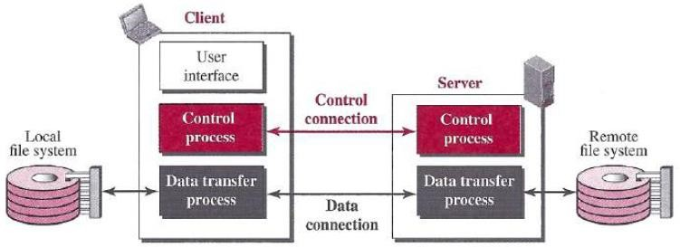
Basic Model of FTP
The client has three components:
the user interface,
the client control process, and
the client data transfer process.
There are two connections:
control connection
data connection
The server has two components:
the server control process and
the server data transfer process.

Slide 16
Cont…
The two connections in FTP have different lifetimes.
The control connection remains connected during the entire interactive FTP session.
The data connection is opened and then closed for each file transfer activity
FTP server uses two well-known TCP ports:
port 21 is used for the control connection,
port 20 is used for the data connection.
Benefits for having two separate connections:
You can have multiple data transfers running at a time without having to establish multiple control connections.
No need for complicated framing on the control connection.
Handling special cases, like cancelling a data connection, is simpler.

Slide 17
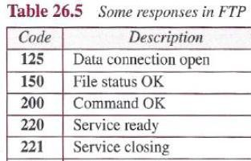
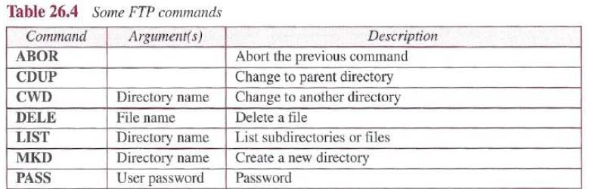
Control Connection
Control communication is achieved through commands and responses.
During this control connection, commands are sent from the client to the server and responses are sent from the server to the client.
The client side of FTP sends the user id and password over this control connection.
Every FTP command generates at least one response
A response has two parts:
Three-digit number : defines the code
Text : defines needed parameters or further explanations

Slide 18
Data Connection
When the server side receives a command for a file transfer over the control connection (either to, or from, the remote host), the server side initiates a TCP data connection to the client side.
FTP sends exactly one file over a data connection and then closes the data connection. For multiple files, it uses multiple data connection.
How data connection is started from server end?
The client, not the server, issues a passive open using an ephemeral port (>1023).
Using the PORT command the client sends this port number to the server.
The server receives the port number and issues an active open using the well-known port 20
and the received ephemeral port number.
Passive Open: A process performs a passive OPEN by contacting TCP and saying “I am here, and I am waiting for clients that may wish to talk to me to send me a message on the following port number”. The OPEN is called passive because aside from indicating that I am listening, the process does nothing.
Active OPEN: A process using TCP takes the “active role” and initiates the connection by actually sending a TCP message to start the connection (a SYN message).

Slide 19
Communication over Data Connection
The heterogeneity problem is resolved by defining three attributes of communication:
file type: ASCII, EBCDIC, or image file.
data structure: file, record, or page structure
transmission mode: stream, block, or compressed mode
The file structure format (used by default) has no structure. It is a continuous stream of bytes.
In the record structure, the file is divided into records. This can be used only with text files.
In the page structure, the file is divided into pages, with each page having a page number and a page header.

Slide 20
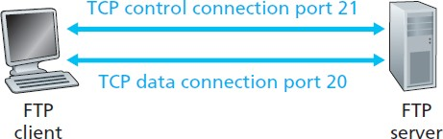
HTTP v/s FTP
HTTP and FTP
Are both application layer protocols
are both file transfer protocols
they both run on top of TCP
FTP uses two parallel TCP connections to transfer a file, a control connection
and a data connection.
HTTP sends request and response header lines into the same TCP connection that carries the transferred file itself
FTP is said to send its control information out-of-band
HTTP is said to send its control information in-band
with FTP, the control connection remains open throughout the duration of the user session, but a new data connection is created for each file transferred within a session (that is, the data connections are non-persistent)
Throughout a session, the FTP server must maintain state about the user.
HTTP, on the other hand, is stateless —it does not have to keep track of any user state.

Slide 21
Security for FTP
The FTP protocol was designed when security was not a big issue.
Although FTP requires a password, the password is sent in plaintext (unencrypted)
To be secure, one can add a Secure Socket Layer (SSL) between the FTP application layer and the TCP layer.
In this case FTP is called SSL-FTP

Slide 22


